Slide 1
A Systems Thinking Approach to the Growth of the Creative Economy of Johannesburg
ORAL DEFENSE: Dphil in Digital Transformation 2023 - 2025
Mariapaola
McGurk

Slide 2
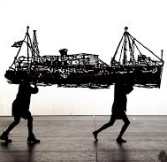
Background
Information
Student: Mariapaola McGurk
Supervisor: Prof. Natanya Meyer

Slide 3
The Creative Economy
Why is this Study Important?
The Creative Economy contributes 3% (R161 Billion) towards GDP in South Africa and an estimated one million jobs (SACO, 2022) which is similar to the Agricultural Industry.
Gauteng Province is the epicentre of the creative economy contributing just under half of the sector’s GDP (SACO, 2022).
The City of Johannesburg has the most established creative economy in South Africa with the majority of creative businesses in South Africa (Oyekunle, 2019)
This industry is starting to be seen as a key area for investment and SMME development which is evident in a variety of governmental departments such as the Department of Trade, Industry and competition; the department of Small Business Developments; and the Department of Communication and Digital Technologies.
However
There is little to no research on strategic growth and development of this industry within the context of South Africa, and in particular, Gauteng Province’s City of Johannesburg
SACO. (2022). The Economic Mapping of the Cultural and Creative Industries in South Africa 2022, Capstone Report.
Oyekunle, O. A. (2019). Creative Industries in South Africa: An Engine for Urban Regeneration.

Slide 4
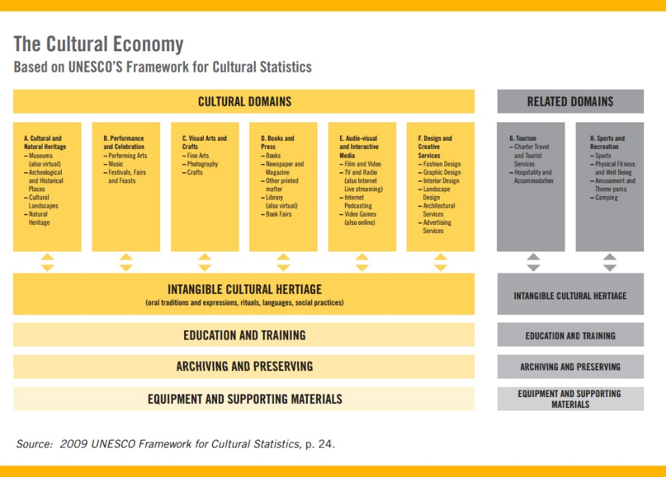
What is the Creative Economy?
UNESCO Framework for cultural statistics (UNCTAD, 2022; UNESCO, 2009:27)
A new term created only in 2001 by John Howkins (Howkins, 2001; UNESCO, 2013).
UNESCO. (2013). Creative economy report 2013 : widening local development pathways.
UNESCO. (2009). The 2009 Unesco framework for cultural statistics (FCS). Unesco Institute for Statistics.

Slide 5
Why a Systems Thinking Approach?
Linear Thinking
Systems Thinking
Systems thinking represents a comprehensive approach to problem-solving, emphasizing the examination of entire systems rather than adopting the conventional method of dissecting problems into isolated components. It is defined as the ability to identify and integrate patterns, interactions, and interconnections within a collection of activities aimed at achieving a particular objective (Dolansky et al., 2020).
Dolansky, M. A., Moore, S. M., Palmieri, P. A., & Singh, M. K. (2020). Development and Validation of the Systems Thinking Scale. Journal of General Internal Medicine, 35(8), 2314–2320.

Slide 6
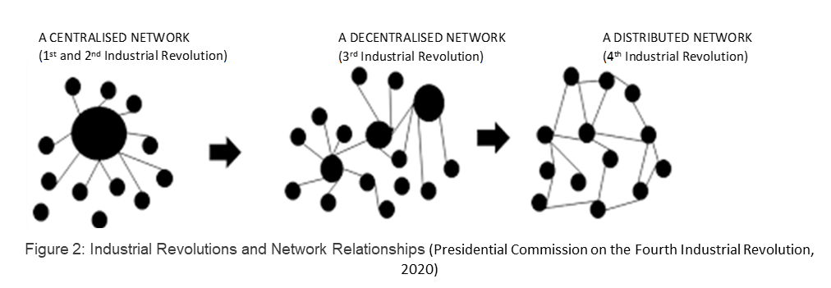
Why a Systems Thinking Approach?
The Link Between a Distributed Network and the CCIs
"Terms such as the social economy, rural economy, green economy, creative and knowledge economy are being used to describe emerging sectors for the fourth industrial revolution, which will manifest in future areas of work. These ''economies" span multiple sectors; for example, the creative economy refers to an economic system that focuses on creative qualities rather than the typical sources of land and capital and includes the creative industries, innovations, and design from the IT, agriculture, mining, and many other sectors. Increased collaboration and cross-sector cooperation will be the hallmark of the fourth industrial revolution"
(Presidential Commission on the Fourth Industrial Revolution, 2020)
Presidential Commission on the Fourth Industrial Revolution. (2020). Diagnostic Report of the Presidential Commission of the Fourth Industrial Revolution. www.gpwonline.co.za

Slide 7
Literature Review
Themes
1.
The Creative Economy
- Terms
- Global
- African Continent
- South Africa
2.
Sustainable Development Goals
- History
- Objectives
- Relationship to the Creative Economy
3.
Local Economic Development
- Relationship between LED and the Creative Economy
5.
Systems Thinking
- Origins and current perspectives
- Case studies/ Comparative studies
- Possible frameworks
4.
Gauteng Province and the City of Johannesburg
- Economic growth strategies
- Challenges and opportunities
- The Creative Economy within this context

Slide 8
Research Methodology
Research Problem of the Study:
The Creative Economy has been recognised globally by governments for its social and economic potential, especially in relation to achieving the SDG goals 2030. This can be seen in South Africa too, however, there appears to be a disconnect between acknowledging its potential and practical implementation to realise that potential.
The Purpose of this Study:
To explore the growth of the creative economy of Johannesburg through a systems thinking approach
The complexity of the creative economy and the many stakeholders is often misunderstood, overlooked and simplified with silo thinking across the private and government departments and sectors.
There is a need for more research, data and synergies to be created in order for the actual value of the creative economy to be realised.

Slide 9
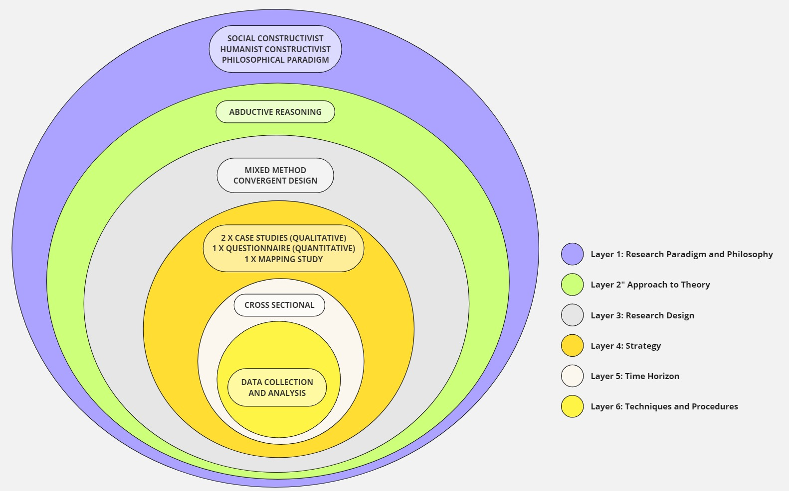
Research Methodology

Slide 10
Qualitative
- 2 x case studies:
a) Systems thinking in action — Contra Fair Johannesburg
b) Building creative entrepreneurs - The role of art and design tertiary education
- Semi-structured interviews x 10
Quantitative
- 132 participants
- Consent form for every interviewee
- Interviews remain anonymous
- Thematic coding and interview comparison for analysis
- Non-probability sampling: Creatives, over 18 professionals, anonymous, online
- Structured survey research instrument using:
a) 8 main factors from (White, et al, 2014) ‘Performance measures and metrics for the creative economy’
b) the 20-item Systems Thinking Scale (Dolansky et al., 2020)
c) Entrepreneurship Orientation (Miller, 1983)

Slide 11
Secondary Objectives | Research
To complete a comprehensive mapping exercise of all the creative organisations and tertiary institutions based within the geographic area of Johannesburg. | Research method: Desktop and Primary Research Mapping the capacity building and institutional creative organisations of Johannesburg.
To gain insights into how creative economy practitioners perceive the industry and its growth. | Research method: Primary Quantitative Research A survey of perceptions of the creative economy from creatives of Johannesburg
To gain on-the-ground perspectives of a systems thinking approach through two case studies showing the impact and interconnectedness of seemingly different elements within the creative economy. | Research method: Primary Qualitative Research Gaining perspectives through 2 case studies Case 1: Open Studios Johannesburg Case 2: The introduction of creative entrepreneurship studies at an art and design tertiary institution
To develop systems thinking visual framework/s that proposes a way forward for the industry's complexity and decentralised nature to be acknowledged and a tangible consideration to be offered. | Research method: Analysis and Interpretation of previous findings The development of a framework/s that can visually represent the complexities of the creative economy while offering a systems thinking approach to its development.

Slide 12
Findings and Recommendations

Slide 13
Findings
Finding 1
Key enablers of the Cultural and Creative Industries of Johannesburg, 12000 views, 179 organisations (Mapping study)
Finding 3
Tertiary institutions have a vital role to play in advancing the CCIs of Johannesburg (Case study 2).
Finding 2
Existing events using systems thinking in Johannesburg (Case study 1)
Finding 5
CCI practitioners of the city are systems thinkers (survey – 20 item STS)
Finding 6
Practitioners see the city as an unsuccessful for the CCIs (survey 6 factors for a successful creative economy)
Finding 4
Insights from CCI practitioners reveal terminological and domain overlays (quant survey).
Finding 7
Proposed adjustments to two of three metrics for CCIs in the South African context through factor analysis (survey – entrepreneurship orientation, and 6 factors for a successful creative economy)

Slide 14
Objective 4:
To develop a systems thinking visual framework(s) that proposes a way forward for the industry’s complexity

Slide 15
Recommendation 1: Understanding Stakeholders
Stakeholders |  | Objective 1 Mapping study | Objective 2 Contra Fair Case study | Objective 2 Entrepreneurship Education | Objective 3 Successful city for the CCIs | Objective 3 Entrepreneurship orientation and Systems thinking scale
Educational institutions | Tertiary
 | Colleges
 | Educational Spaces
Capacity training organisations
Creative hubs
Makerspaces
Access to market: | Galleries
 | Markets
 | Venues
Funding bodies | Government funding
 | Embassies
 | International organisations
Government | Local
 | Provincial
 | National
Annual Activities | Festivals
 | Art Fairs
 | Events
Advocate organisations
Cultural and Creative Practitioners | Domain A:
 | Domain B:
 | Domain C:
 | Domain D:
 | Domain E:
 | Domain F:
Property developers
Social media and marketing specialists
Corporate partnerships
Inner city small businesses
Industry experts
Domestic and international tourism
Citizens of Johannesburg
Custodians of the inner city
Researchers
Business and industry mentors
High tech companies
Responsibility for the growth of the CCIs is shared, not singular. It requires collaboration from multiple stakeholders, each adding unique value to the industry.

Slide 16
Recommendation 2: Bold, Collaborative, and Transformative Leadership.
“The most successful creative economy movements have started with a Disruptive Leader Disruptive leaders possess a deep understanding of the nonobvious, developing solutions with a heightened creativity, solving problems and addressing risks, finding the right trade-offs, and essentially recognizing the “wicked” opportunities in the “wicked” problems. These disruptive leaders can scan the environment, identify trends, and envision the future.”
Government Leadership
Tertiary Institution Leadership
CCI Leadership
Successful Creative Economy
(Tardif, 2020, xvii)

Slide 17
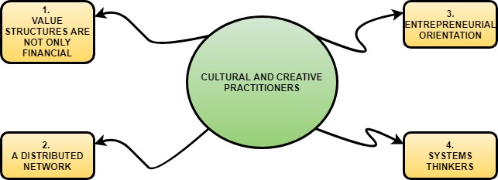
Recommendation 3: Understand the Nature of Cultural and Creative Practitioners
Cultural and creative practitioners do not need to adapt to other systems; instead, their unique system and nature must be understood by those aiming to grow this industry.

Slide 18
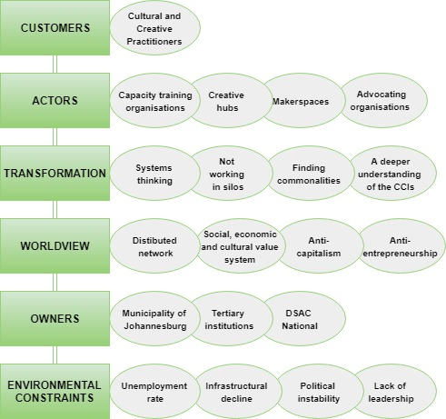
Recommendation 4: Applying CATWOE to Johannesburg’s Cultural and Creative Industries

Slide 19
Recommendation 5: Applying the Quadruple Helix Model
Government
Industry
University
DSAC
DTI
Local Government
Provincial Government
National Government
DSBD
Art and Design Departments
Business Departments
Research entities
All six domains
Tech Industry
Business and Economics
Civil Society
Cultural and Creative entrepreneurs, practitioners, and organisations
(Colapinto & Porlezza, 2012; Leydesdorff & Etzkowitz, 2003)

Slide 20
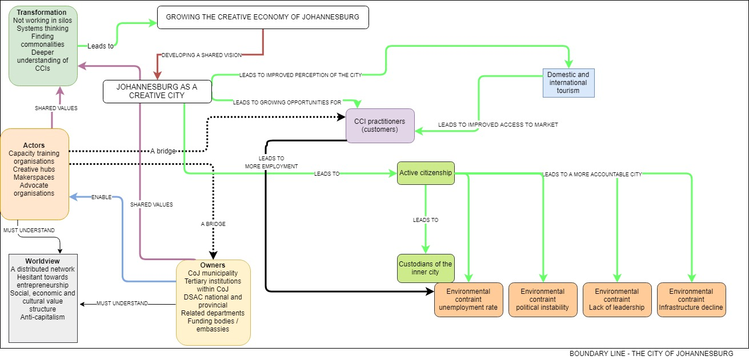
Recommendation 6: Strategic Systemigram Overview

Slide 21
Dissemination of Research
Reaching Different Stakeholders
Academic
Conferences: IBC, SACO
Academic Articles
Cultural and Creative Practitioners
Blogs on my website
Facebook posts
Government, Investors and Corporate
Online engagements with Political Parties such as Rise Mzansi
Expert contribution to reports
LinkedIn posts
Thesis
Possible Workshops

Slide 22
Contribution of the study
Theoretical contribution
Practical contribution
Methodological contribution
There is limited research done on the Creative Economy of the City of Johannesburg. It is intended that this research allows for some theoretical basis to be formed around the larger value of the creative economy for LED and SDG within South Africa’s cities and in particular the City of Johannesburg.
This research will offer practical considerations for the various stakeholders on how to approach the implementation of strategies for the growth of their sector/department within the larger context of the creative economy. It will include frameworks and case studies.
The 3 metrics within the survey on creatives of the City of Johannesburg has not been done before and will allow for further research and developments related to the creative economy and its growth.

Slide 23
Limitation of Study
Quantitative Research to have a further reach especially entry-level CCI practitioners.
Qualitative Research – Further case studies involving capacity training organisations
Mapping study – Including a qualitative component to understand the story of place in Johannesburg; field work to allow more practitioners to add to the map.
Expand the research to include all three cities of Gauteng Province and do a province wide study.

Slide 24

Thank you, any question

Slide 25
A Systems Thinking Approach to the Growth of the Creative Economy of Johannesburg
Mariapaola
McGurk

